Slide 1
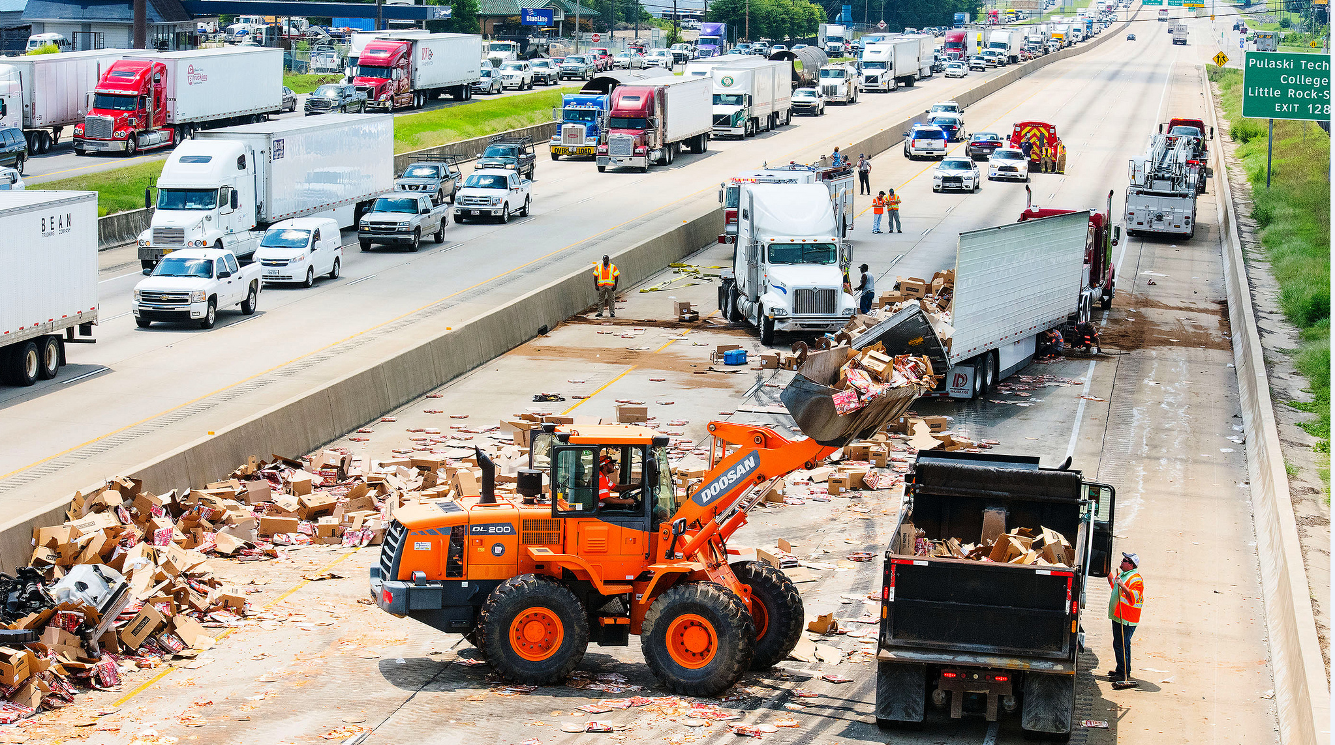

Traffic Incident Management Performance Measures
Andy Brewer
August 2019

Slide 2



Slide 3
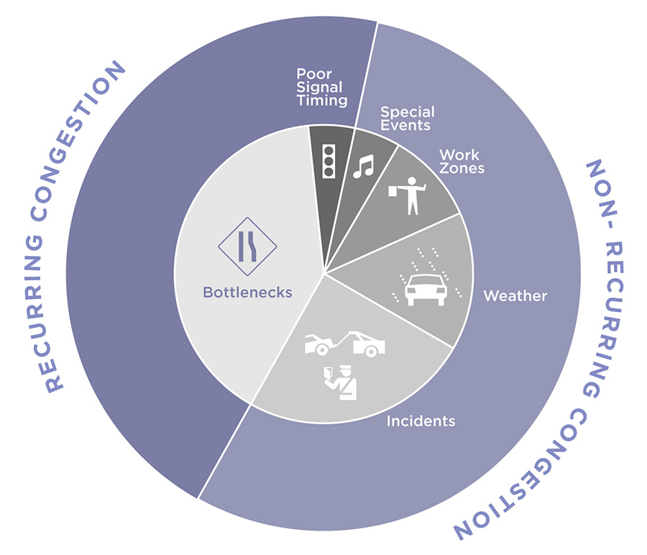
5%
5%
10%
40%
15%
25%
Source: FHWA

Slide 4

5%
5%
10%
40%
15%
25%
Source: FHWA

Slide 5
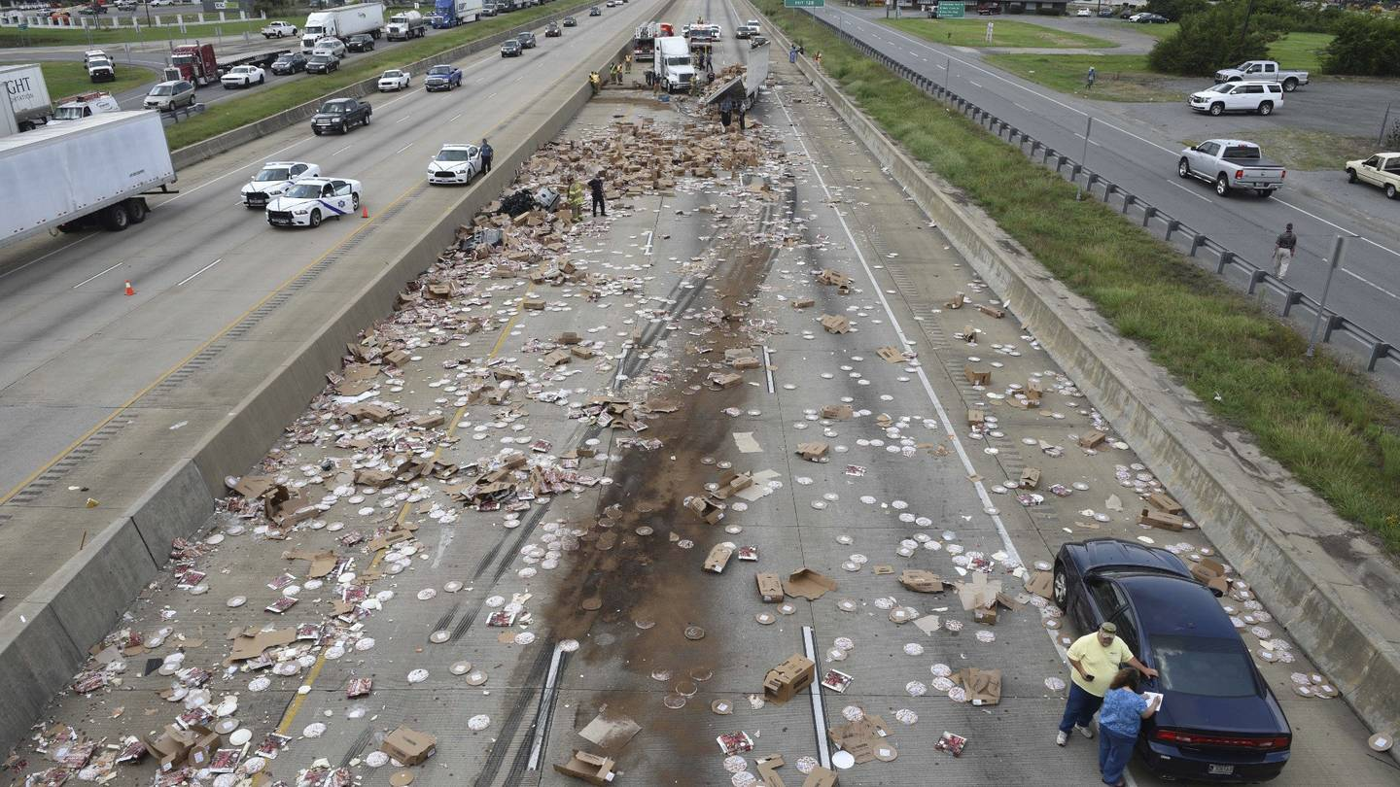

Slide 6
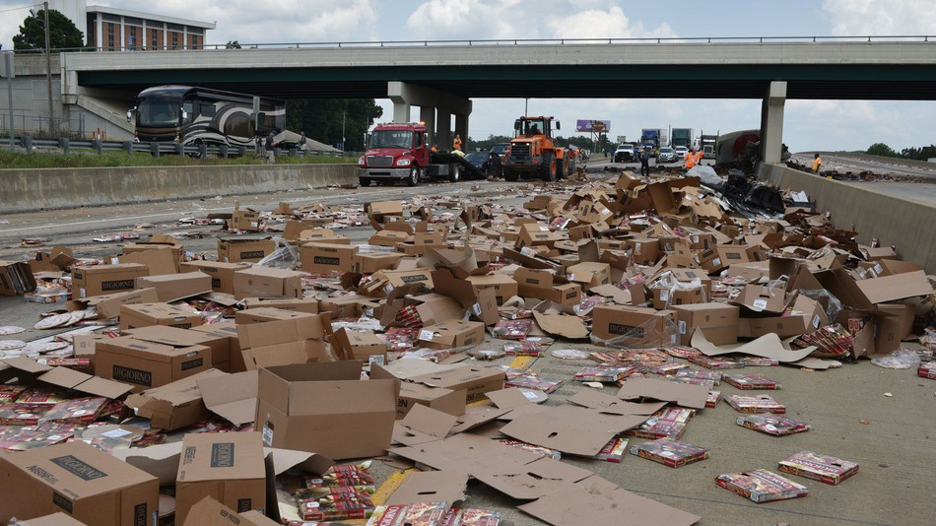


Slide 7
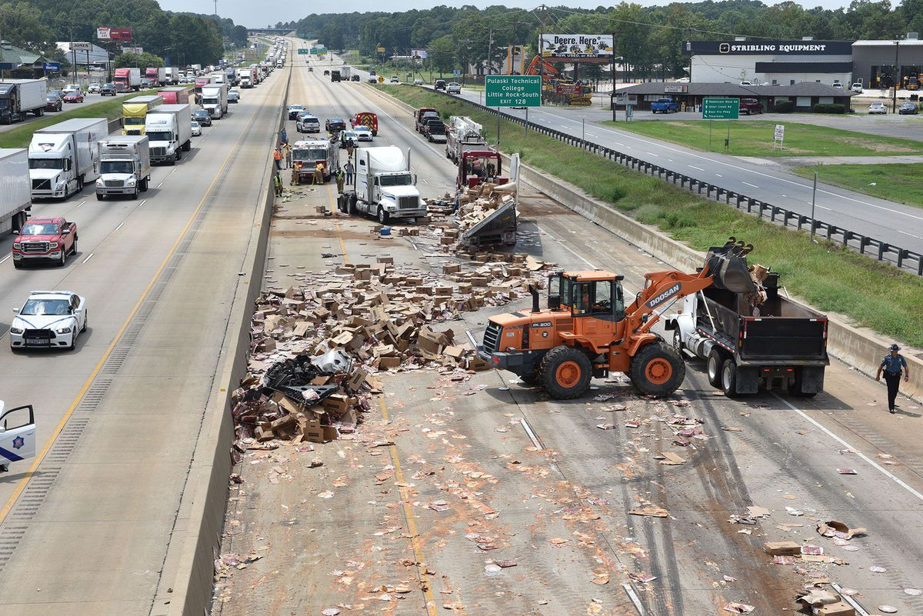

Slide 8
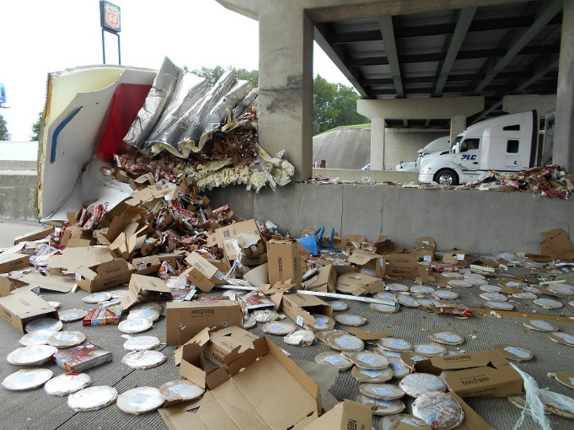
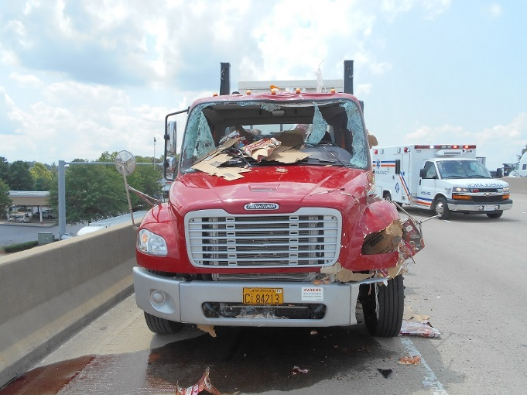

Slide 9





Slide 10
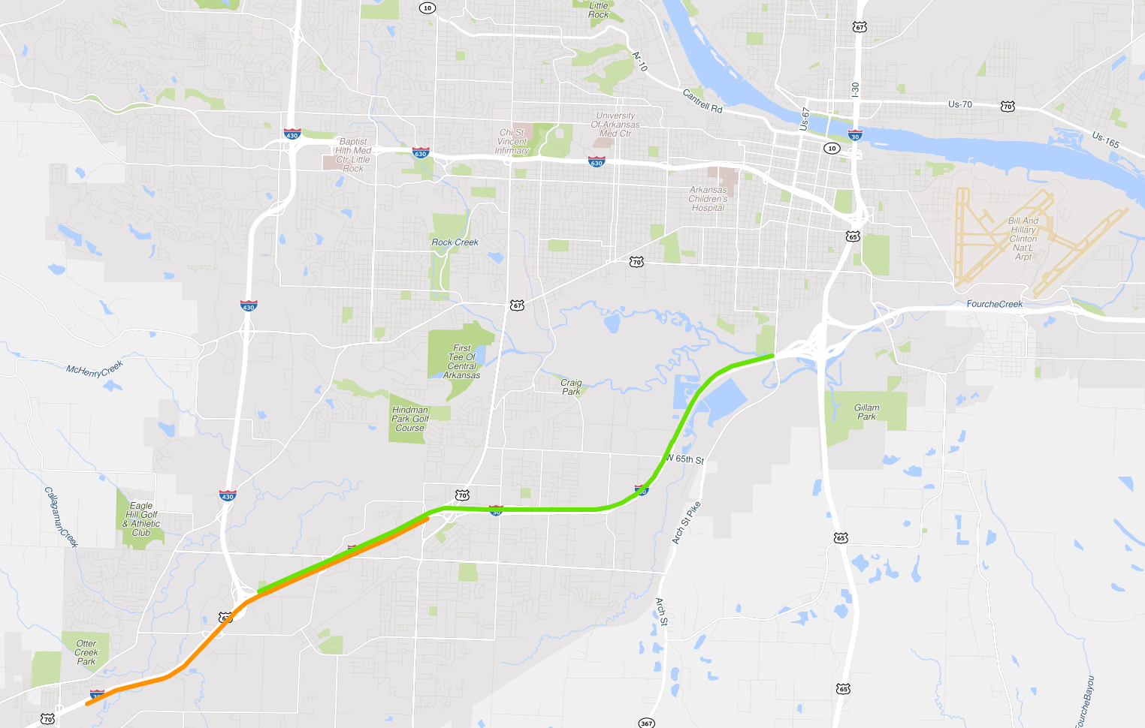

Slide 11
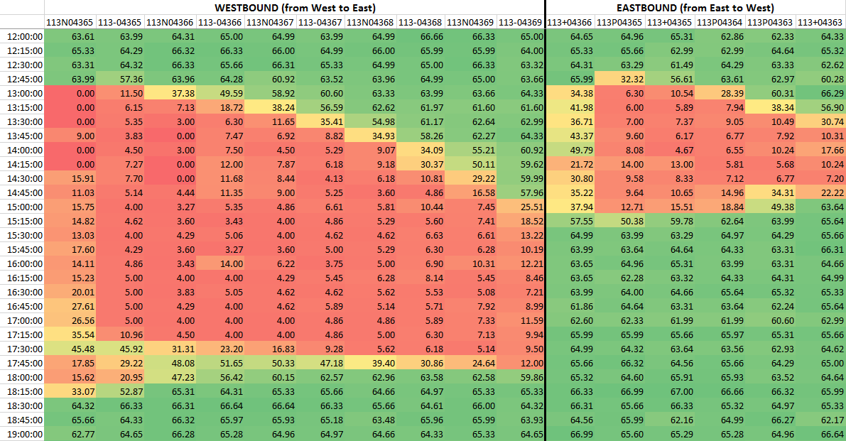

Slide 12


Slide 13


Slide 14
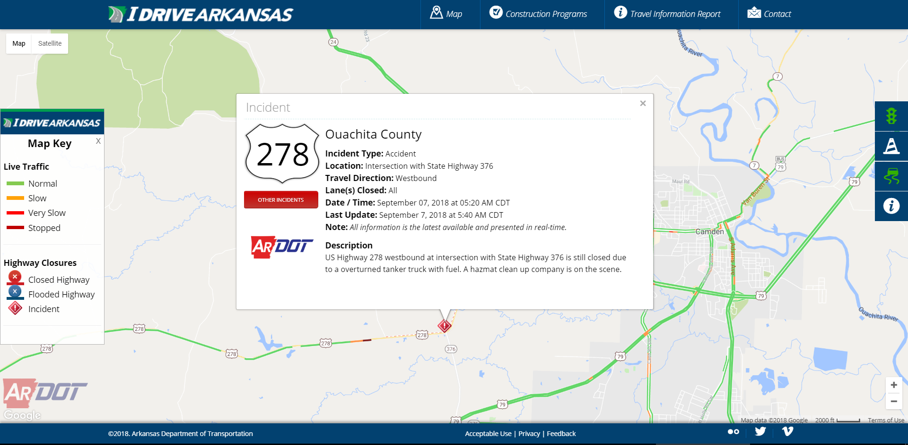

Slide 15
Reason for Highway Closure, First Half of 2019
By Number of Events
accident | 1553
high water | 213
disabled vehicle | 201
towing | 133
vehicle fire | 107
other | 106
maintenance | 52
tree down | 45
closed bridge | 33
powerline down | 32
structure fire | 8
pipe failure | 7
construction | 6
slide | 4
grass fire | 2
wash out | 2

Slide 16
Reason for Highway Closure, First Half of 2019
By Total Closure Time (minutes)
high water | 2,010,528
pipe failure | 174,266
accident | 105,927
closed bridge | 65,707
other | 41,232
maintenance | 40,994
slide | 39,079
powerline down | 23,348
towing | 10,659
vehicle fire | 9,408
disabled vehicle | 7,419
wash out | 5,547
construction | 4,161
tree down | 3,256
structure fire | 1,204
grass fire | 16

Slide 17
Reason for Highway Closure, First Half of 2019
By Average Time (minutes)
pipe failure | 24,895
slide | 9,770
high water | 9,439
wash out | 2,774
closed bridge | 1,991
maintenance | 788
powerline down | 730
construction | 694
other | 389
structure fire | 151
vehicle fire | 88
towing | 80
tree down | 72
accident | 68
disabled vehicle | 37
grass fire | 8

Slide 18
Reason for Highway Closure, First Half of 2019
By Median Time (minutes)
slide | 10,928
pipe failure | 6,026
high water | 4,483
wash out | 2,774
closed bridge | 388
construction | 337
powerline down | 227
maintenance | 223
structure fire | 69
tree down | 47
vehicle fire | 47
accident | 46
other | 43
towing | 26
disabled vehicle | 21
grass fire | 8

Slide 23
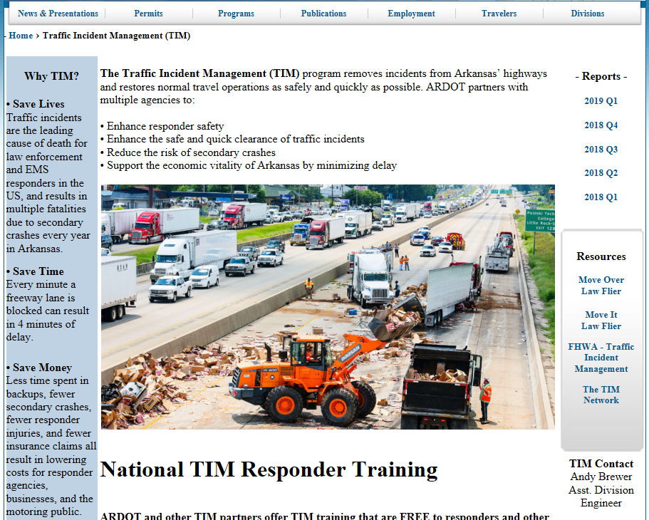

Slide 24
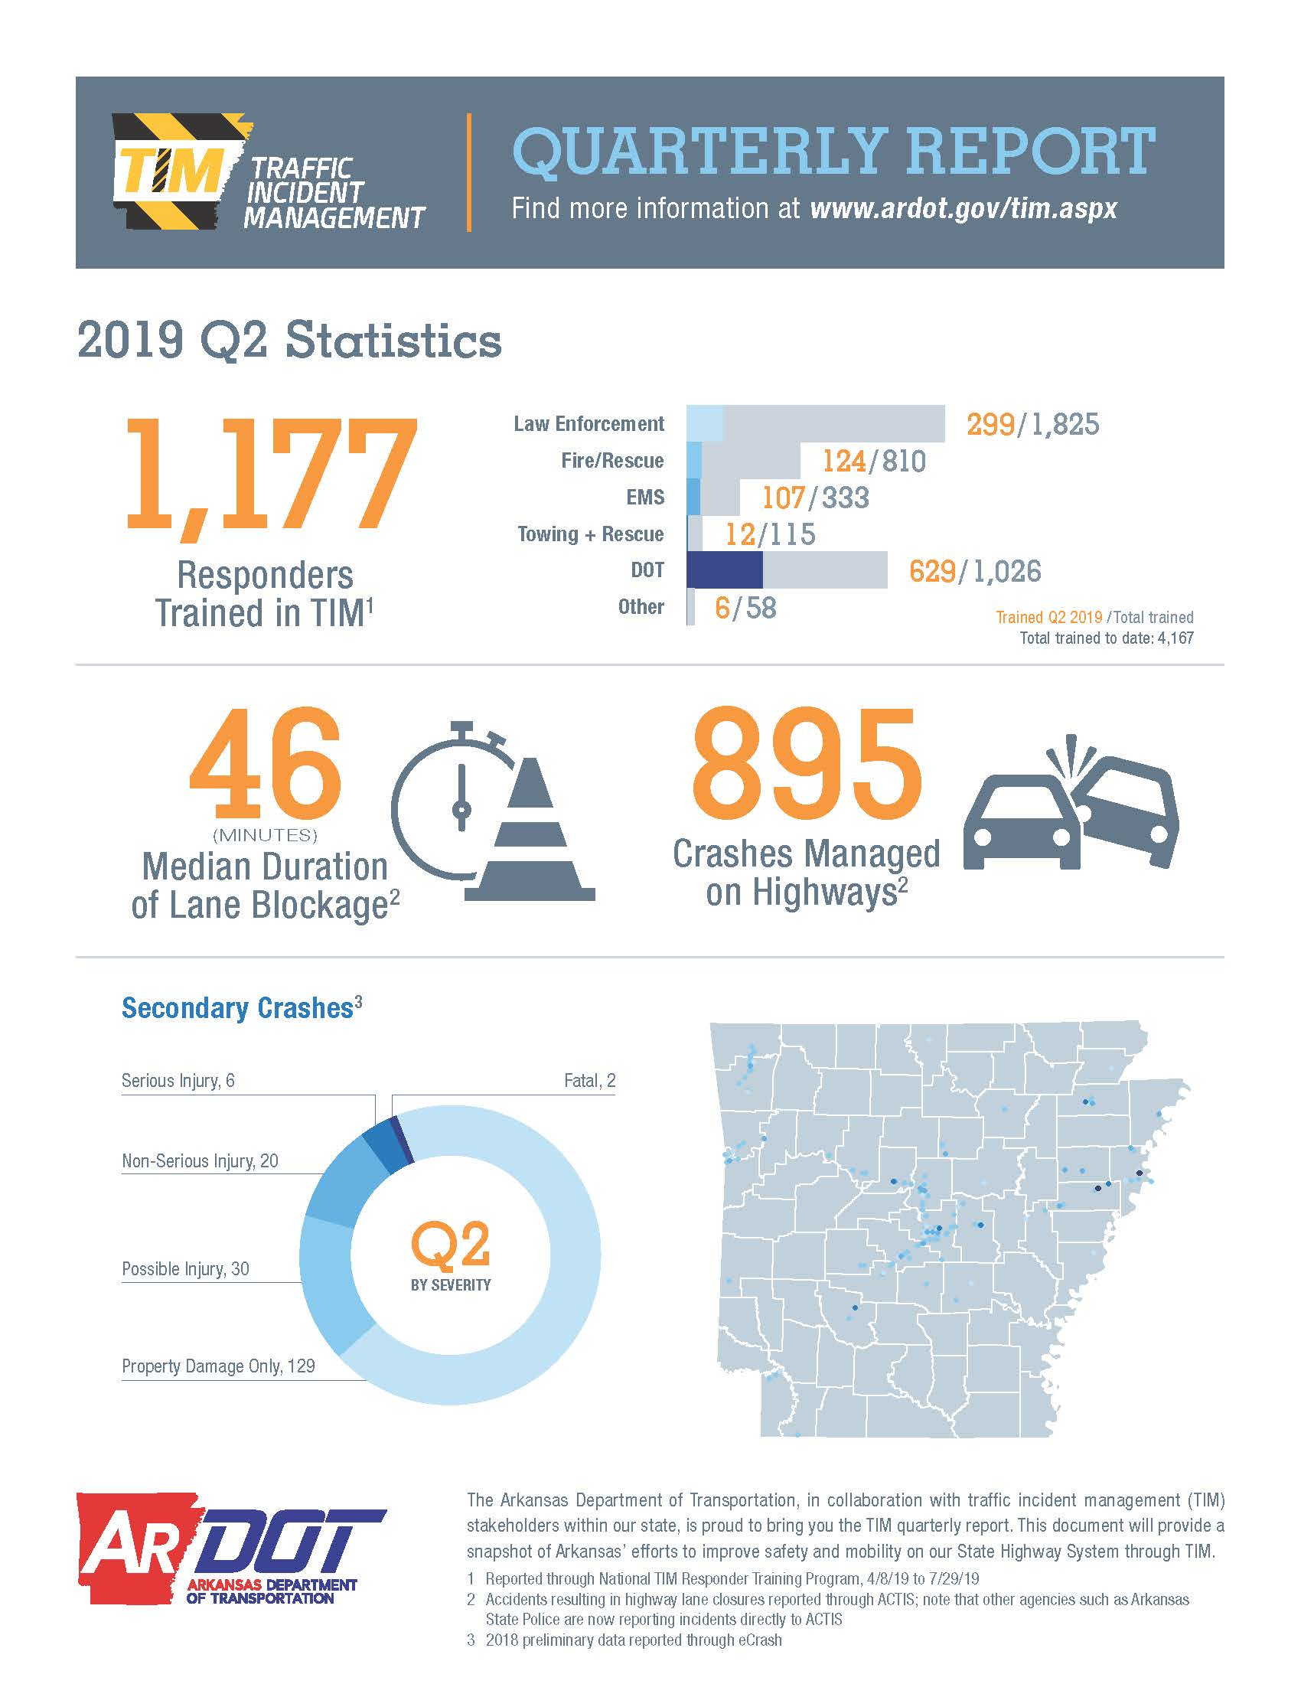

Slide 25
TIM Training Program Implementation Progress
Percent Trained – Goal of 45%
- As of July 29, 2019
NH: 30.9%
(7,175)
23.2%
(20,777)
37.7%
(10,502)
VT: 61.2%
(2,796)
22.4%
(7,510)
30.2%
(3,993)
16.3%
(21,542)
24.9%
(26,350)
MA: 60.2%
(10,068)
7.2%
(11,781)
55.9%
(4,930)
37.1%
(39,698)
15.4%
(54,443)
RI: 62.7%
(4,080)
34.6%
(3,770)
22.4%
(32,555)
32.3%
(20,139)
25.2%
(54,500)
NJ:
55.9%
(29,798)
CT: 44.8%
(3,120)
56.4%
(8,224)
54.9%
(18,000)
43.7%
(37,126)
25.0%
(7,831)
26.5%
(54,699)
19.8%
(30,546)
46.8%
(19,894)
39.5%
(13,830)
DE: 13.3%
(4,715)
56.3%
(8,300)
37.5%
(31,000)
60.2%
(18,177)
50.2%
(53,082)
34.1%
(71,223)
MD: 32.5%
(23,218)
41.6%
(57,680)
50.6%
(26,061)
55.3%
(27,357)
DC: 34.1%
(6,534)
29.5%
(22,500)
11.2%
(9,932)
39.2%
(10,627)
45.9%
(14,331)
25.7%
(18,172)
13.3%
(17,103)
50.4%
(28,532)
5
0.1 - 14.9% Trained
50.6% (78,309)
44.1%
(11,394)
8
15 - 24.9% Trained
AK: 12.3%
(4,797)
13
25 - 34.9% Trained
23.8% (39,576)
9
35 - 44.9% Trained
HI: 30.5%
(3,270)
PR: 60.0%
(12,698)
7
45 - 54.9% Trained
36.4% | Percent Trained
(1,158,265) | Total Responders To Be Trained
10
55+% Trained

Slide 26
Number of Incident Responders trained in TIM in Arkansas
Total
LE
DOT
Fire
EMS
Tow
Other

Slide 27
Secondary Crashes, First Half of 2019

Slide 28


Slide 29
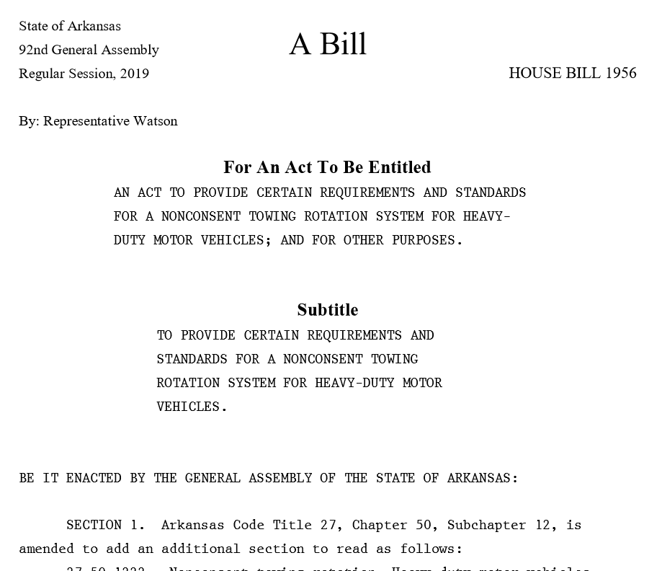
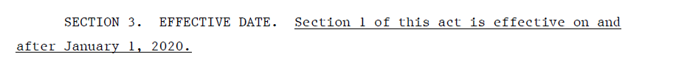

Slide 30
Improve Data

Slide 31
Arkansas Law Enforcement Agencies on eCrash System

Slide 32
Improve Data
Improve Analytics

Slide 34
? %
? %
? %
? %
? %
? %

Slide 35
Data Quality
Data Analytics
Back of Queue
Performance Management

Slide 36
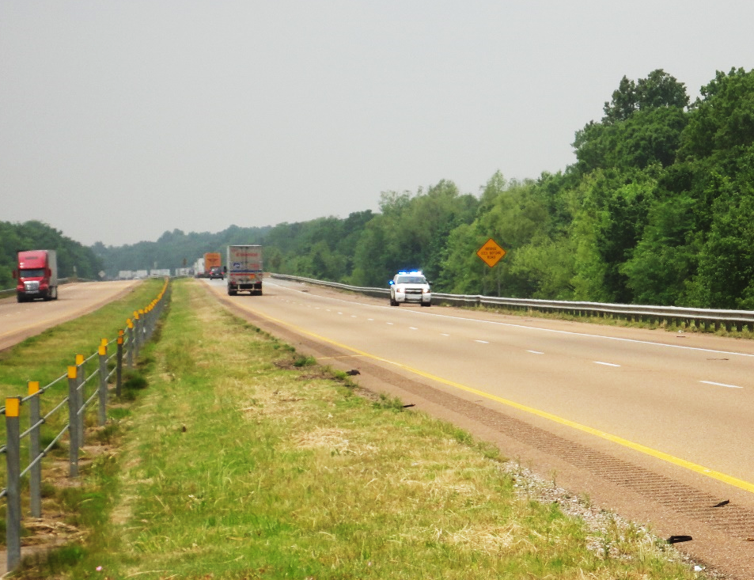

Slide 37
Data Quality
Data Analytics
Back of Queue
Training
Performance Management

Slide 38
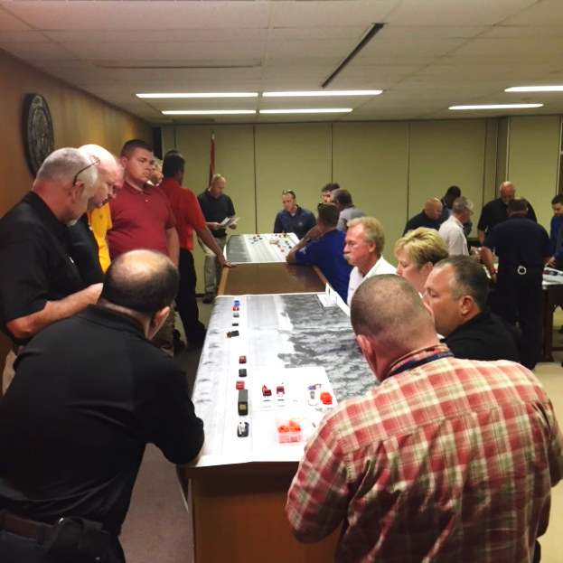

Slide 39
Data Quality
Data Analytics
Back of Queue
Training
ITS
Performance Management

Slide 40
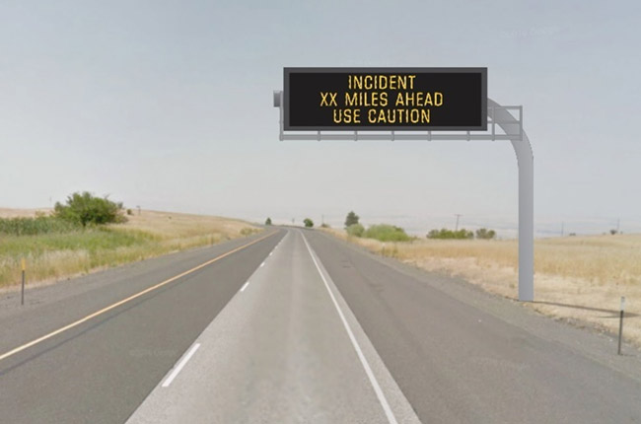

Slide 41

Data Quality
Data Analytics
Back of Queue
Training
ITS
Performance Management
Traffic Incident Management
Planning Operations

Slide 42

Questions?

